Slide 1
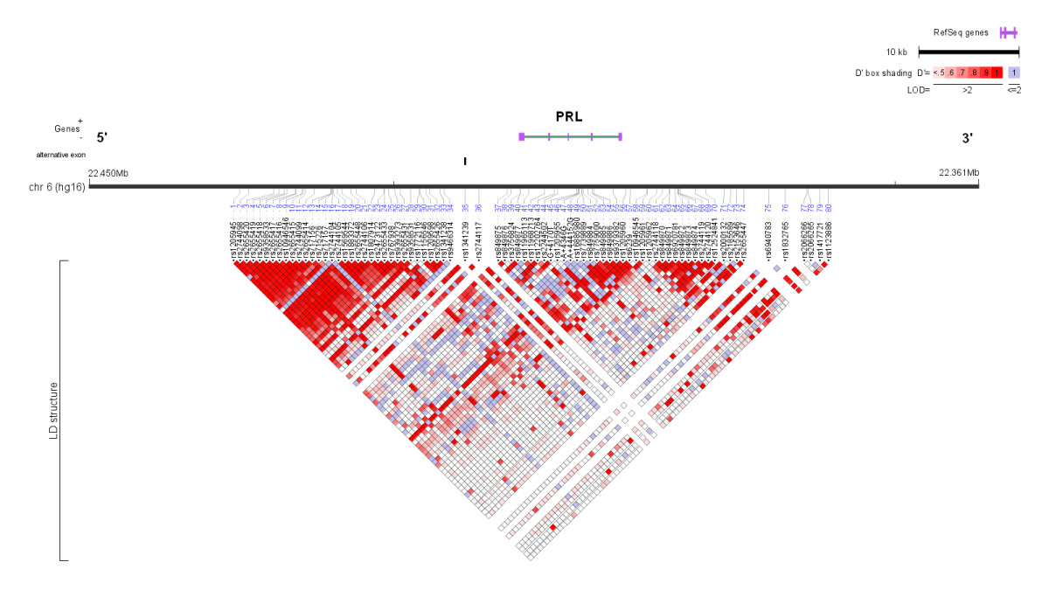
Linkage

Slide 2
Linkage disequilibrium
LD: Non-random association of alleles at difference loci
“Linkage disequilibrium is influenced by many factors, including selection, the rate of recombination, the rate of mutation, genetic drift, the system of mating, population structure, and genetic linkage. As a result, the pattern of linkage disequilibrium in a genome is a powerful signal of the population genetic processes that are structuring it.”
A set of SNPs is in “linkage equilibrium” if they are independent.

Slide 3
Sometimes LE sets of markers are useful
Speed up computation.
Remove redundant info
Lessen likelihood of chip influences.
Chips pick up certain SNPs by design, not a random set of SNPs.

Slide 4
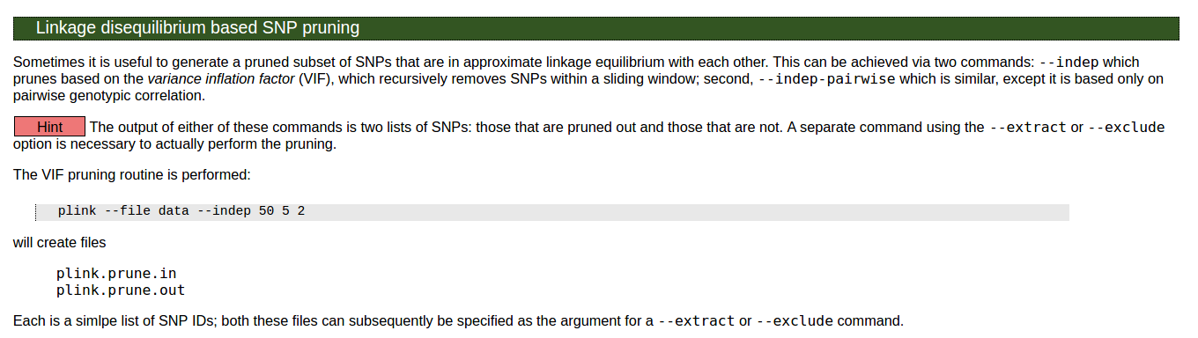

Slide 5
Before we dive into today’s lecture:
Fire up new ec2 session.
Go through code in the lab1-solutions file.
Goal: create a common set of markers for YRI, CEU, and MEX populations.

Slide 7

Population Stratification 2016 Summer Workshop CEDUA El Colegio de Mexico, A. C.
Ben Domingue

Slide 8
Today’s Goals

Slide 9
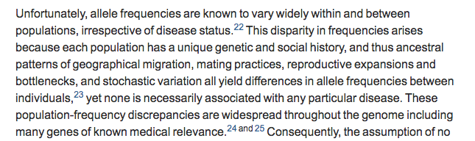
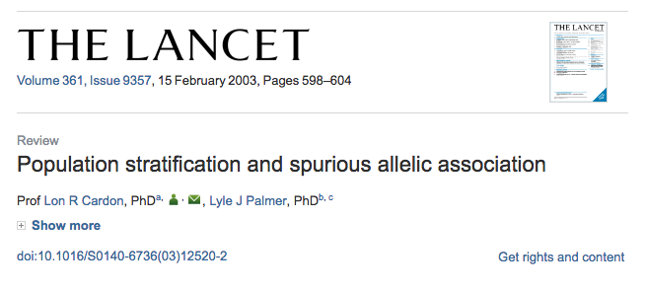
What is population stratification (pop strat)?

Slide 10
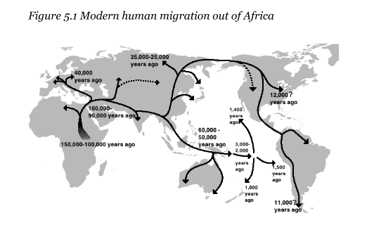
Why does it exist?

Slide 11
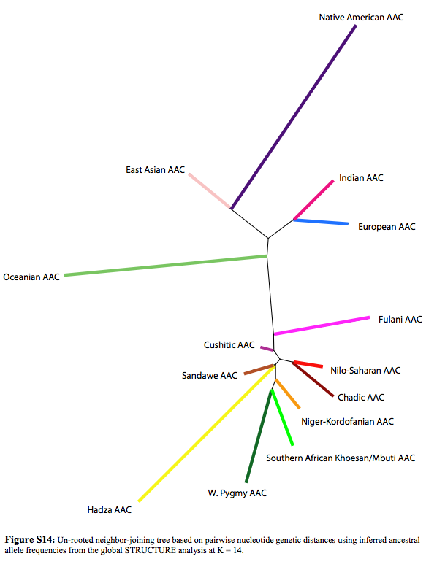
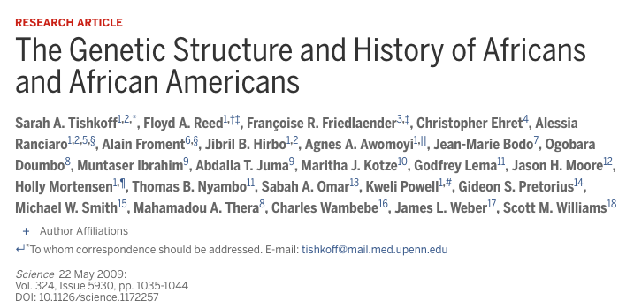

Slide 12
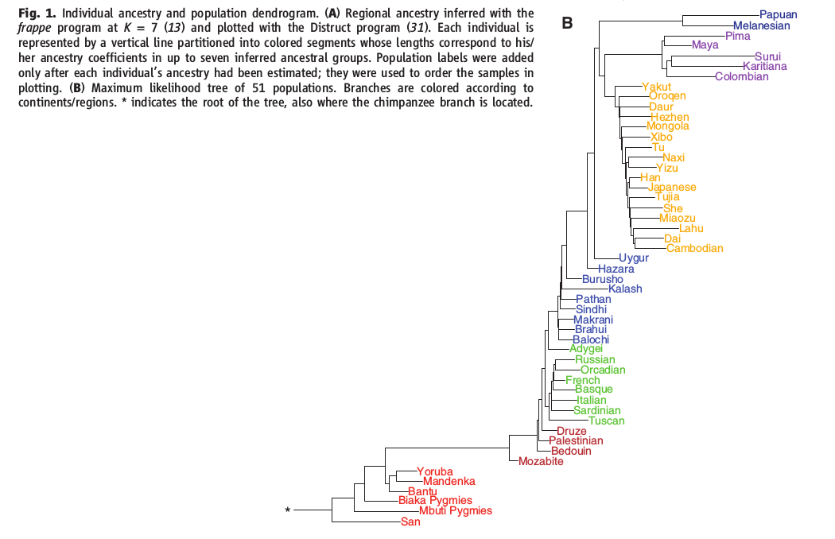
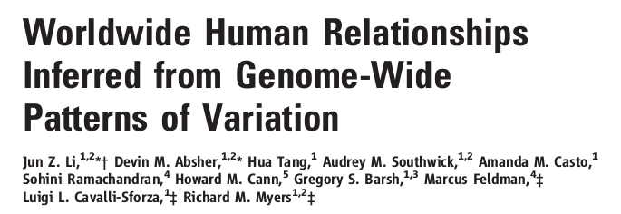

Slide 13
How does it come about
Selection: Change in allele frequency due to survival and reproductive advantages associated with a phenotype.
Drift: Change in allele frequency due to random sampling.
Hard to distinguish between the two.

Slide 14
Technically relevant details
Linkage
Haplotype
Tag SNPs

Slide 15
Linkage map
Tag SNPs
Linkage patterns vary across population.
Tag SNP in one group may not tag same gene in different population.

Slide 16
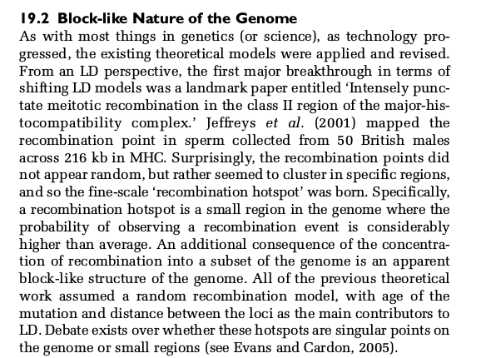
Why do we see this?

Slide 17

Haplotypes
A haplotype is a group of genes or alleles inherited together from a parent
So if you know someone’s genotype at one location, you know everything in that haplotype (thanks to HapMap)
This is the basis for
“imputation”

Slide 18
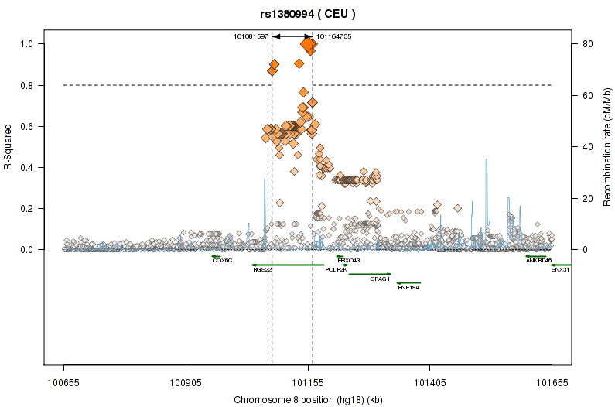
Tag SNPs

Slide 19
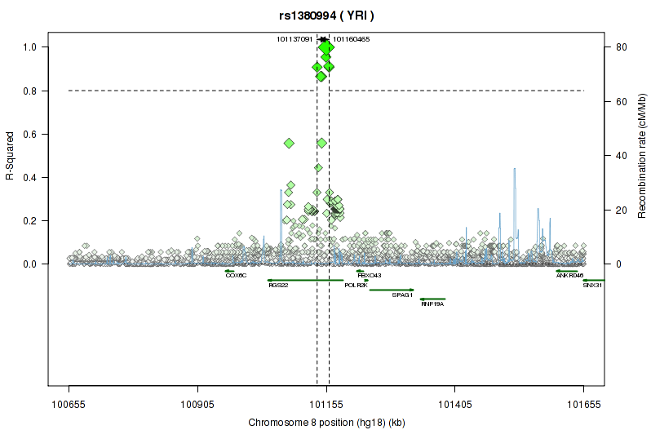
Tag SNPs

Slide 20
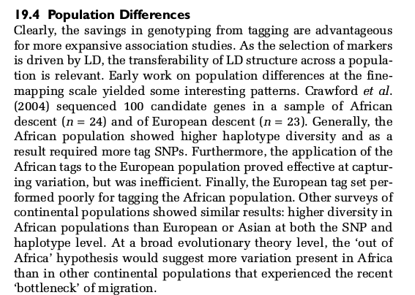
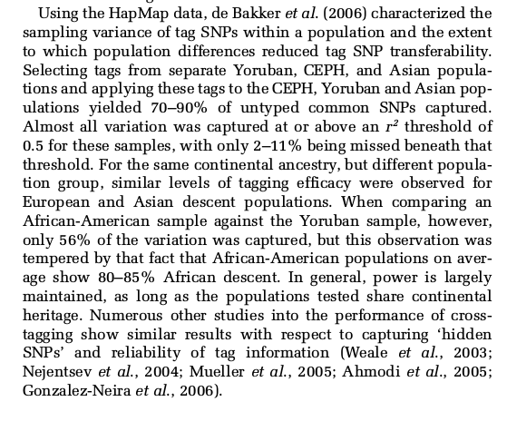
Tag SNPs and populations

Slide 21
Emphasizing the problem of getting things wrong

Slide 22
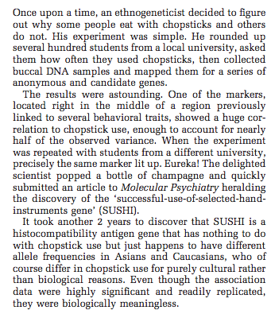
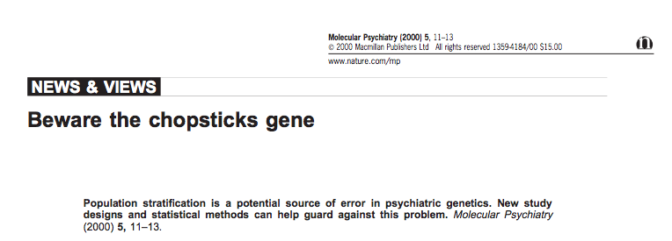
Chopsticks gene

Slide 23
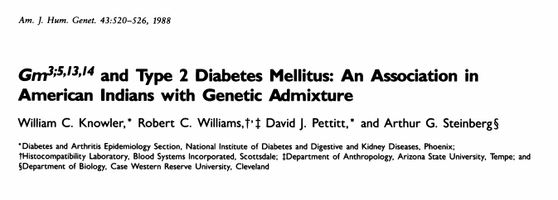
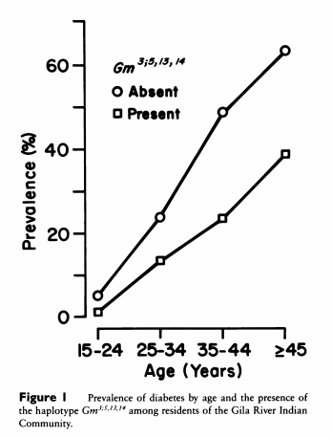
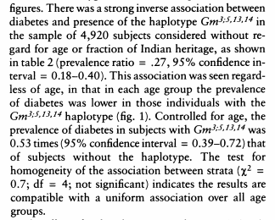
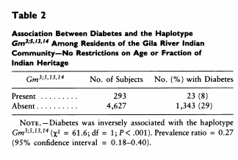
Classic example

Slide 24
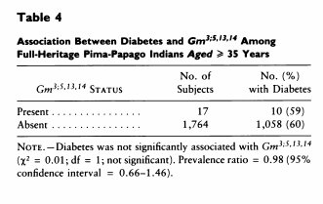
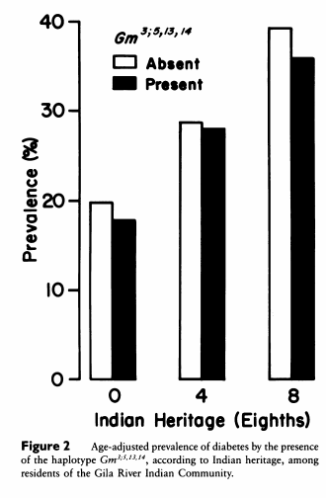
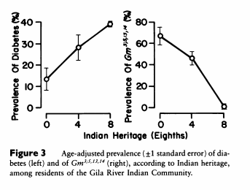
But association not present in homogenous sample (table 4) and is collinear with ancestral heritage.

Slide 25
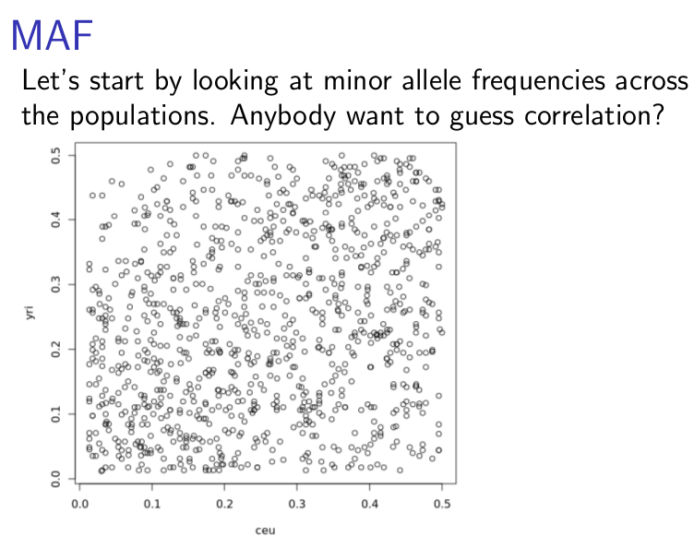
With genome-wide data, problem appears in minor allele frequencies

Slide 26
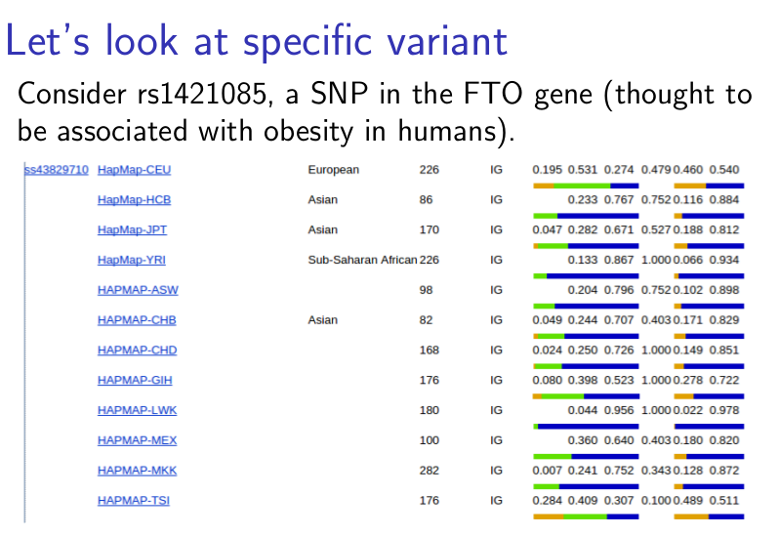

Slide 27
What to do about it
We’re going to talk about some analytical approaches that might be useful in working with heterogeneous groups.

Slide 28
PCs
Explore this brief tutorial on general idea:
http://setosa.io/ev/principal-component-analysis/
In context of genome-wide data, we are basically interested in identifying major sources of genetic variation. These end up having interesting properties.

Slide 29
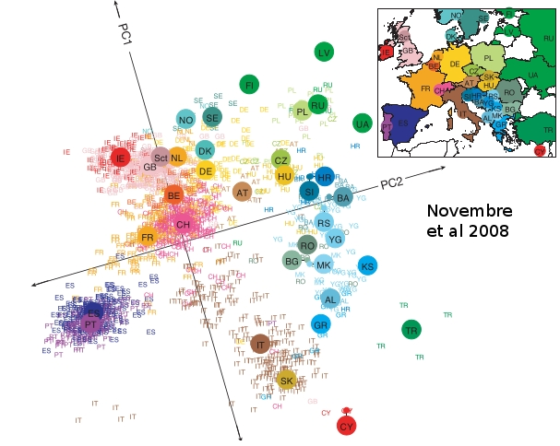

Slide 30
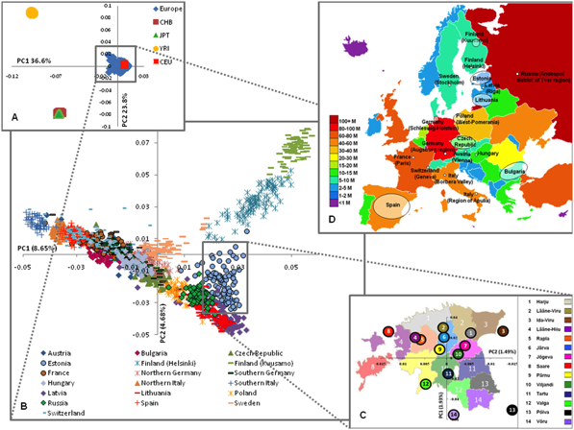
Nelis et al., 2009

Slide 31
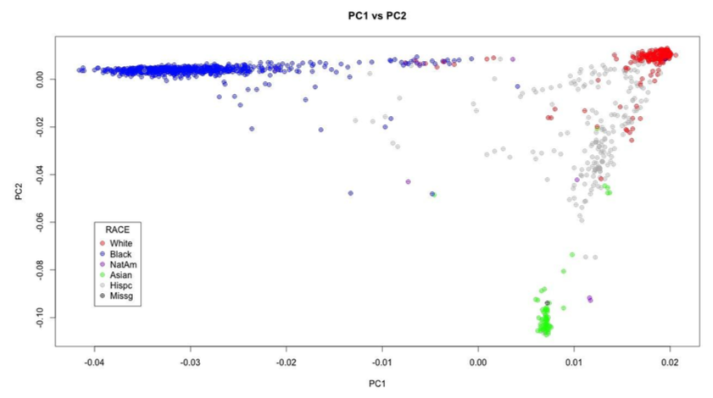
Principal Components by race
McQueen et al., 2014

Slide 32
Admixture
Interbreeding between previously isolated populations

Slide 33
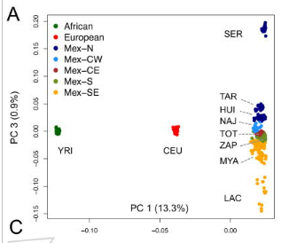
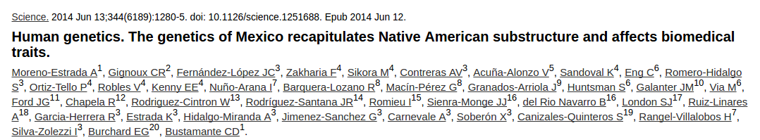
Paper on mexico

Slide 34
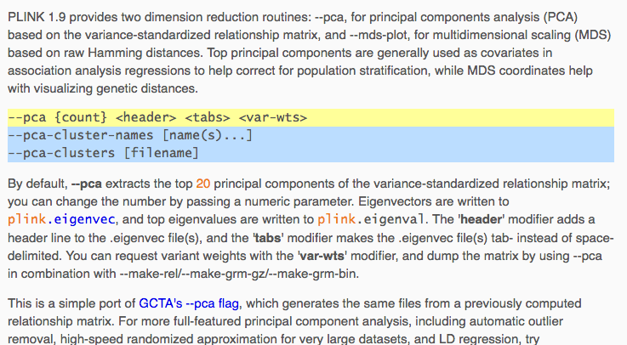
PCs

Slide 35
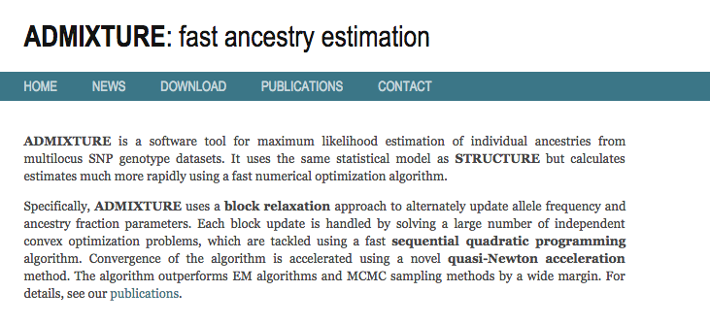
admixture
An alternative is to try to direction estimate ancestry.

Slide 36
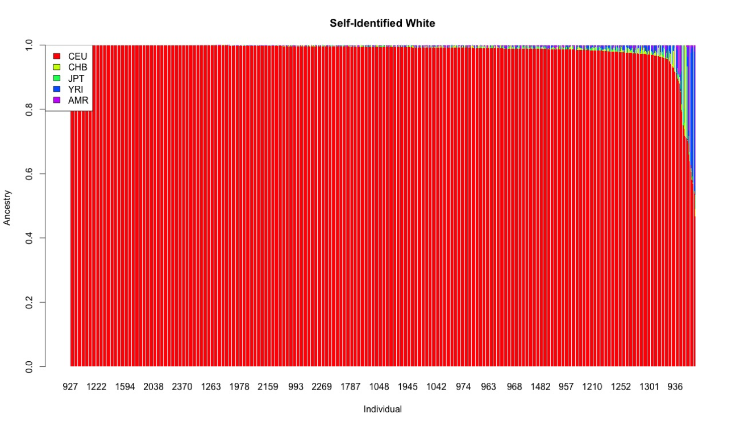
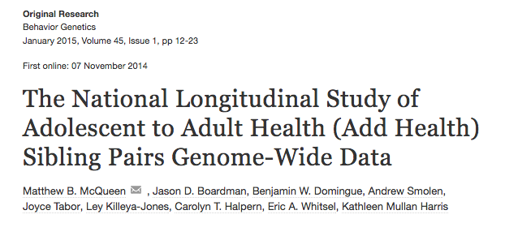
Examples from AH

Slide 37
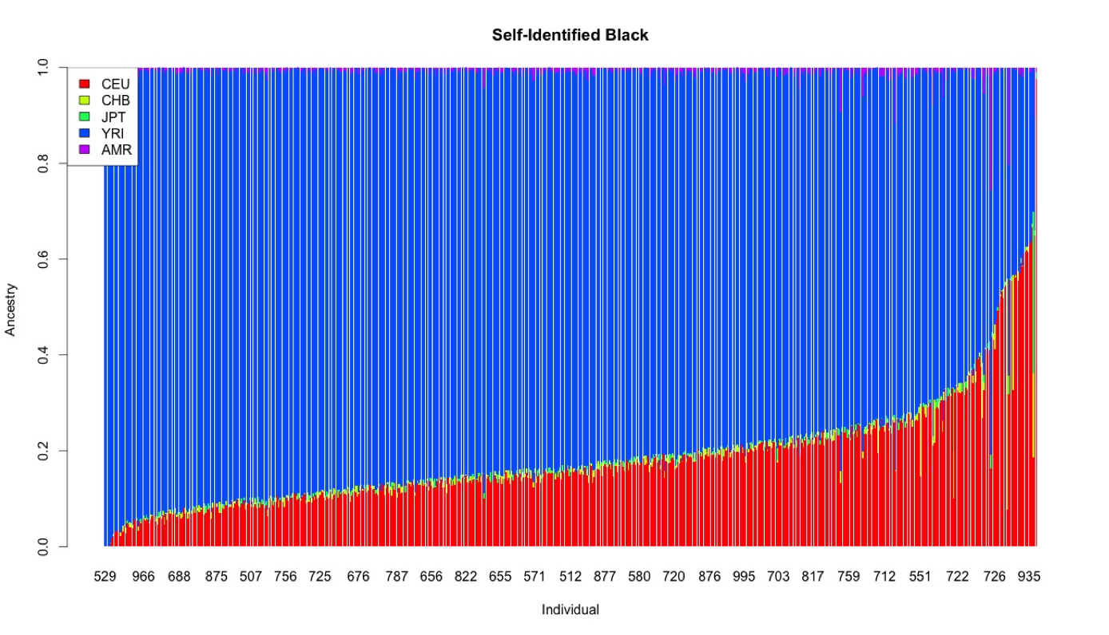
Examples from AH

Slide 38
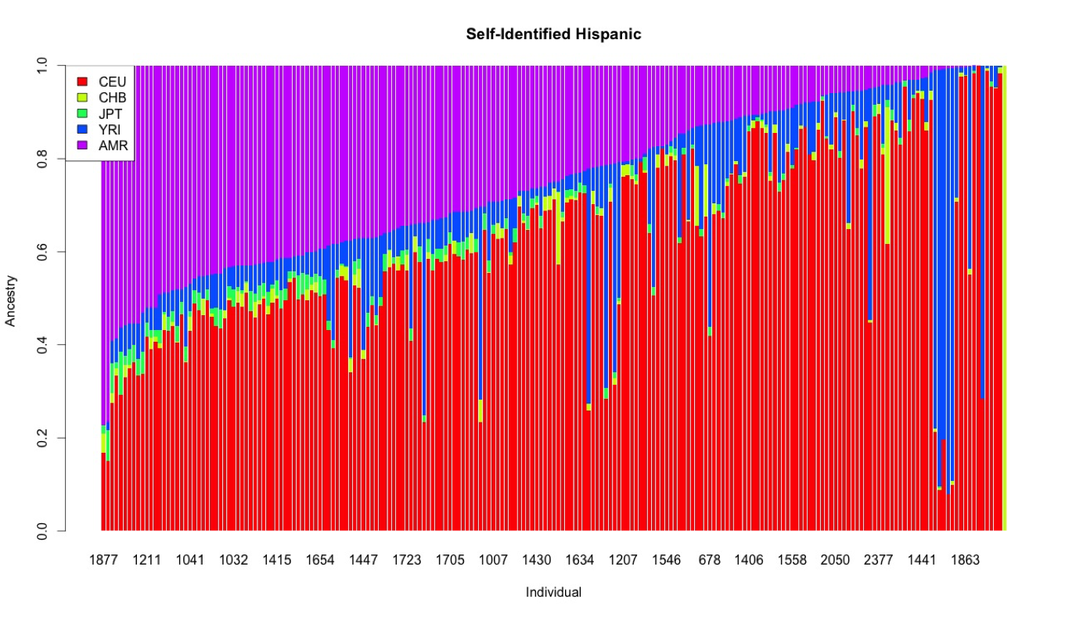
Examples from AH

Slide 39
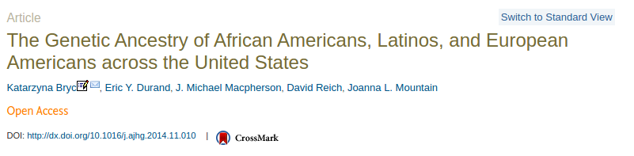
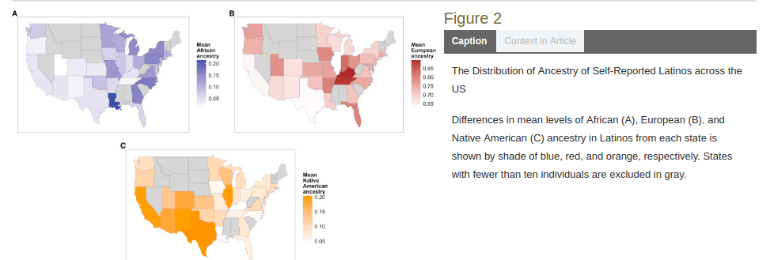

Slide 40
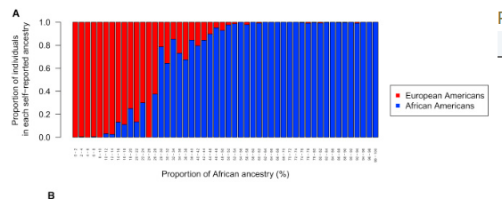
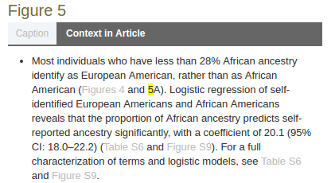

Slide 41
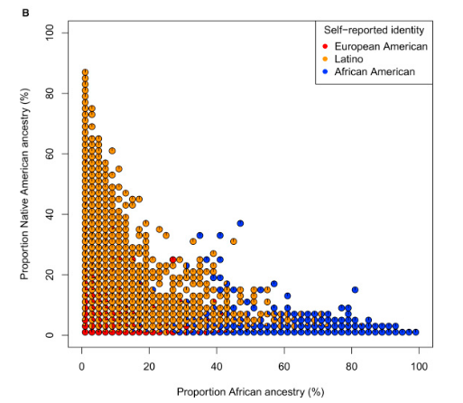
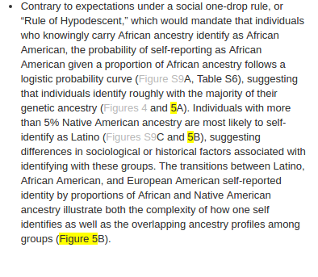

Slide 42
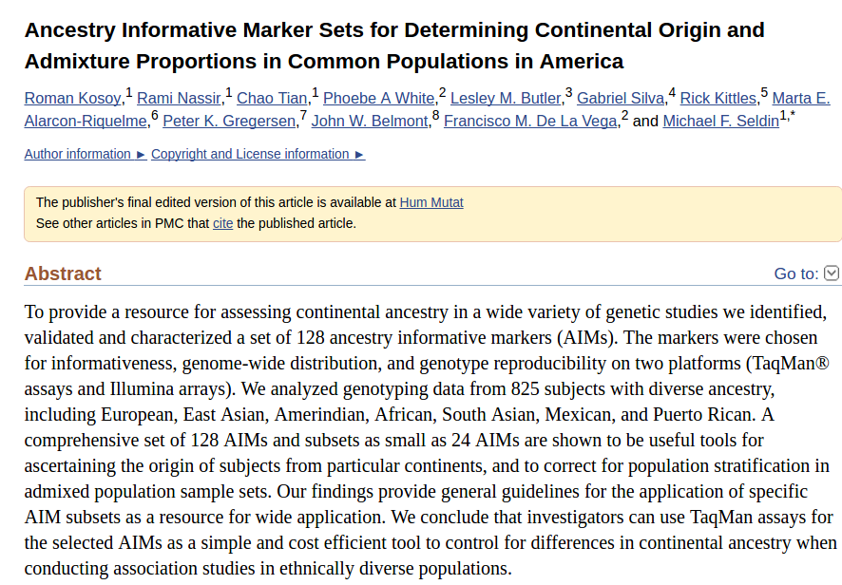
AIMs

Slide 43
Implications for social science
Race: socially constructed?

Slide 44
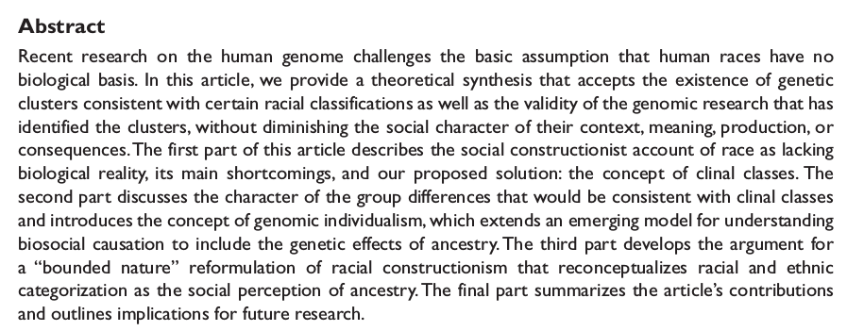
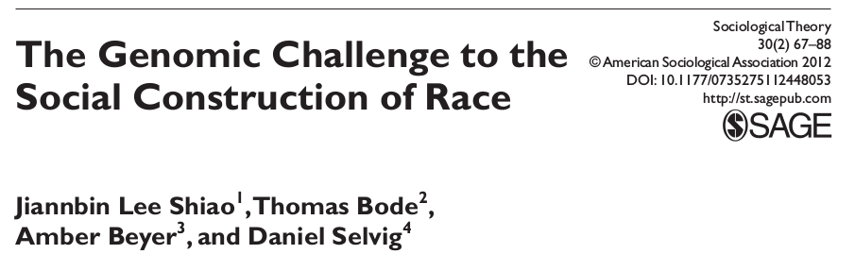

Slide 45
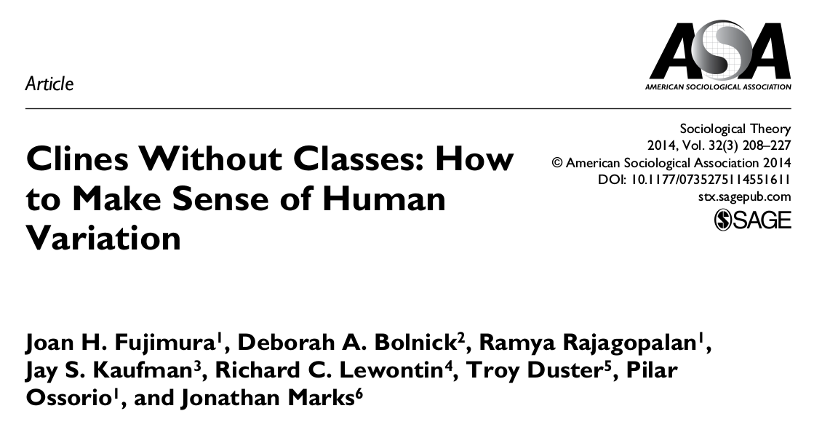
A strongly worded reply

Slide 46
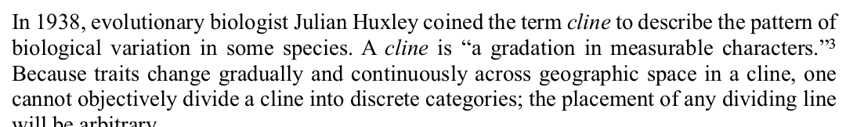
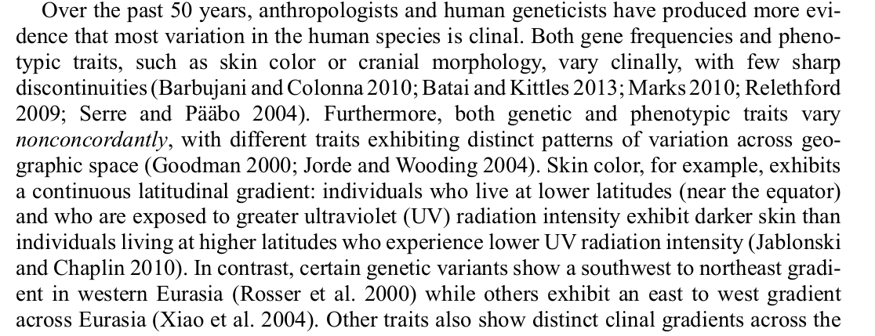
Clines not classes

Slide 47
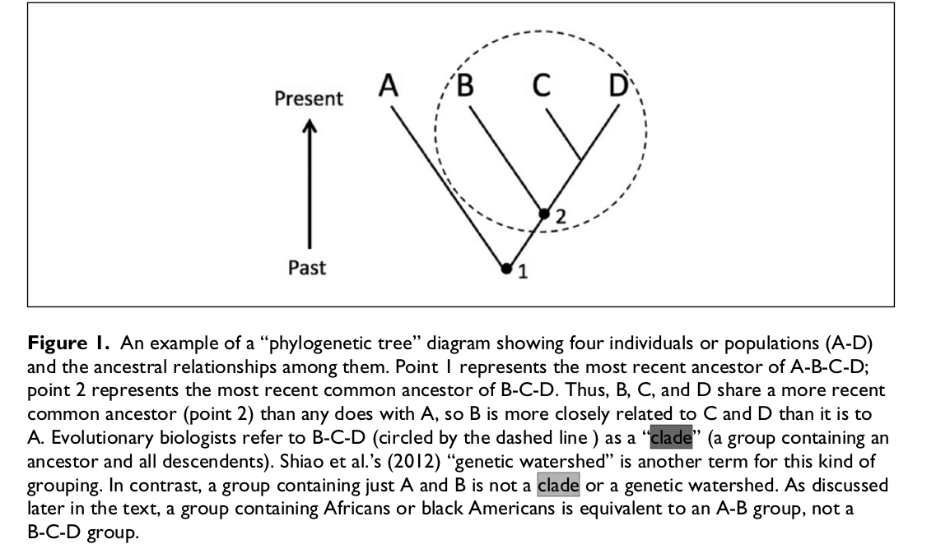

Slide 48
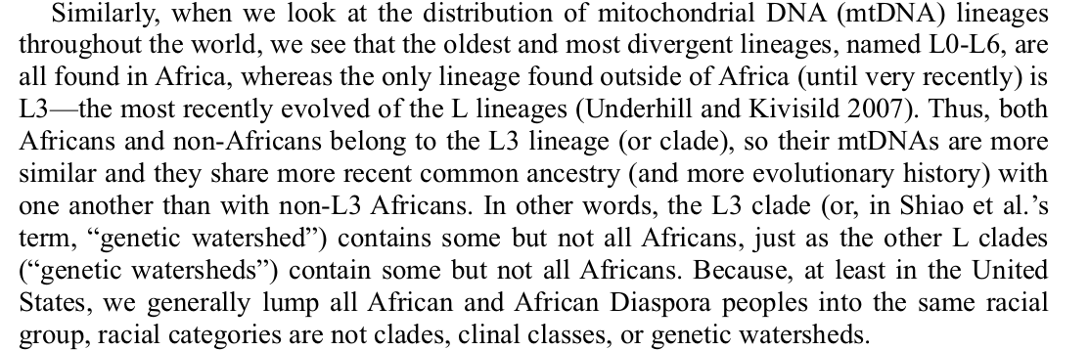

Slide 49


Slide 50
Research Focus #2
Based on your literature search yesterday and the data you noted, please start to outline a specific research question.
Rough is very ok at this point!
Do a second literature search focusing in on the particular topic you are curious about.
Please note any commonly occurring names in the literature!

